Slide 1


DASHBOARD TO ANALYZE IMPORT AND EXPORT
ANALYSIS OF INDIA
20ADC33 – DATA ANALYSIS
MONISHA K (21ADR029)
MOHAMED RIZWAN M (21ADR028)
DINESH KUMAR B (21ADR013)
NAVEENAN M (21ADR031)
Department of AI
Kongu Engineering College
Perundurai

Slide 2
Problem Statement
Maintaining the proper balance between import and export is essential for a country and to reduce the Indian import expenditure and raise its profit through exports.
A country's import and export activities can have an impact on its GDP, exchange rate, degree of inflation, and interest rates. They will benefit from it as the economy of our nation grows.
For that, the comparison of the products that India import from other countries and try to reduce the import of some products by producing that product on our own, but it can be done only with the help of clear knowledge about the past records of import and export of our country.

Slide 3
Introduction
An import is a good or service that is made overseas and bought in your native nation. When native industries are unable to provide comparable goods and services affordably or effectively, customers are attracted to imported goods and services.
A good or service that is exported is one that is produced in one nation but is sold to a customer abroad. Export is one of the earliest forms of trade and occur often between nations
International trade is important for the Indian economy, as it allows it to import and export a variety of goods. Exporting to new areas can increase sales and profits, allowing companies to capture a large portion of the global market.

Slide 4
Business Objective
from the analysis we can increase the production of the highly exporting products.
from the analysis we can decrease the imports from other countries to increase our economy.
we can introduce some new products according to the demand previous product

Slide 5
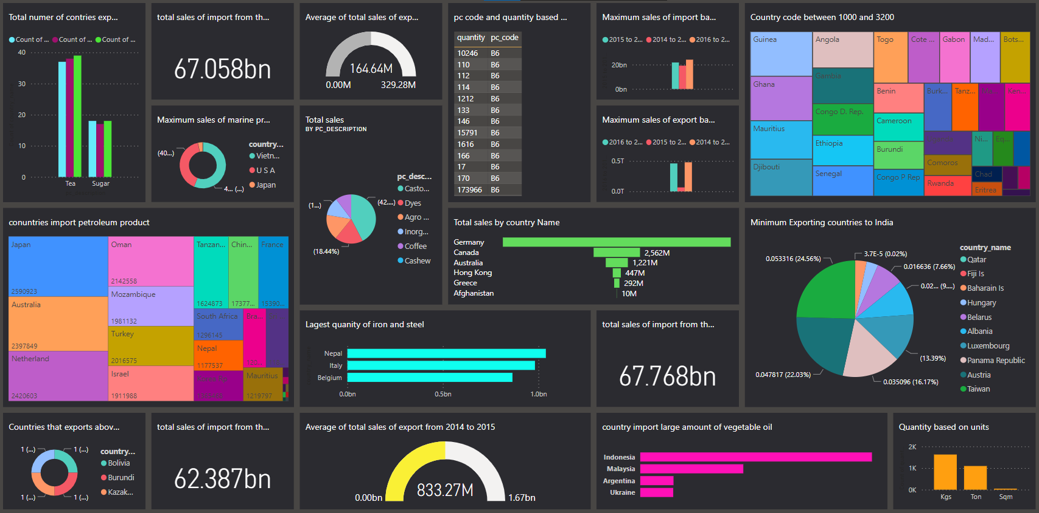
Dashboard
The Power BI publishing dashboard is a powerful tool that enables users to easily create, share and publish interactive Power BI dashboards with their colleagues
With the dashboard, you can quickly create visualizations and insights from your data, as well as gain access to a range of advanced features, such as automatic refresh, data alert notifications, security and privacy settings, and more.

Slide 6
Inference
Among Germany, Canada, Australia, Hong Kong, Greece and Afghanistan, Germany is the most profitable country and the next country is Canada.
The total cost of imports in the year 2014-2015 is the highest among the three years.
Most of the marine products were exported to Vietnam, USA and Japan from India.
while comparing the export of tea from India is higher in 2015-2016 as 39 countries and the export of sugar from India is higher in the year 2015-2016 and 2016-2017 as 18 countries.
The maximum sales were achieved in imports in 2016-2017 and exports in 2014-2015.
Castor oil and dyes were the most profitable products.
The average export sales from India is highest in 2014-2015.

Slide 7
Conclusion
It can be used to calculate the number of countries importing or exporting that particular products to India.
It is used to calculate the which type of goods are imported and exported to the specific country.
It is used to calculate a particular product's minimum export or import.
It is used to calculate a particular product's maximum export or import.
Year wise analysis can be done with this dashboard

Slide 8
References
Dutta, M. (1965). Import structure of India. The Review of Economics and Statistics, 295-300.
Bhattacharyya, M. (1989). Import intensity of exports: A case study of Indian economy. Indian Economic Journal, 36(3), 94.
Goldar.B. (2017). Determinants of import intensity of India’s manufactured exports under the new policy regime. In Perspectives on Economic Development and Policy in India (pp. 217-232). Springer, Singapore.
Kumar, M. R., & Janagam.D. (2011). Export and import pattern of medicinal plants in India. Indian Journal of Science and Technology, 4(3), 245-248.

